Slide 1
DSA 503
ESTIMATION & HYPOTHESIS TESTING: TWO POPULATIONS MEANS

Slide 2

INFERENCES ABOUT THE DIFFERENCE BETWEEN TWO POPULATION MEANS FOR INDEPENDENT SAMPLES: ₁ AND ₂ KNOWN
Independent versus Dependent Samples
Mean, Standard Deviation, and Sampling Distribution of x₁ – x₂
Point & Interval Estimation of μ₁ – μ₂
Hypothesis Testing About μ₁ – μ₂

Slide 3
Independent versus Dependent Samples
Definition
Two samples drawn from two populations are independent if the selection of one sample from one population does not affect the selection of the second sample from the second population. Otherwise, the samples are dependent.

Slide 4
Mean, Standard Deviation, and Sampling Distribution of x₁ – x₂
Three conditions:
The two samples are independent
The standard deviations σ₁ and σ₂ of the two populations are known
At least one of the following conditions is fulfilled:
i. Both samples are large (i..e., n₁ ≥ 30 and n₂ ≥ 30)
ii. If either one or both sample sizes are small, then both populations from which the samples are drawn are normally distributed.
Then the sampling distribution of x₁ - x₂ is (approximately) normally distributed.

Slide 5
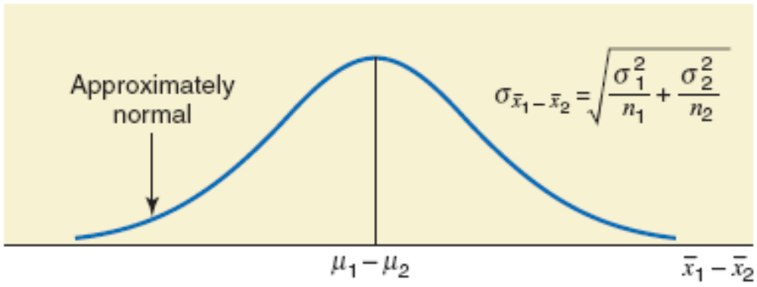
Figure 10.1
.

Slide 6
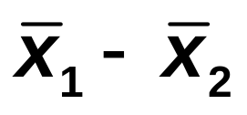
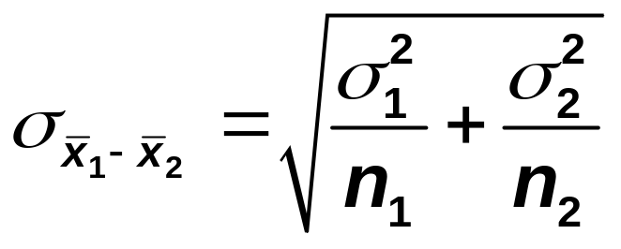
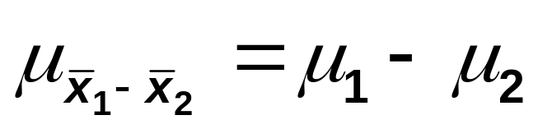
Sampling Distribution, Mean, and Standard Deviation of x₁ – x₂
When the conditions listed on the previous page are satisfied, the sampling distribution of is (approximately) normal with its mean and standard deviation as follows:
and

Slide 7
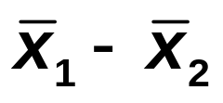
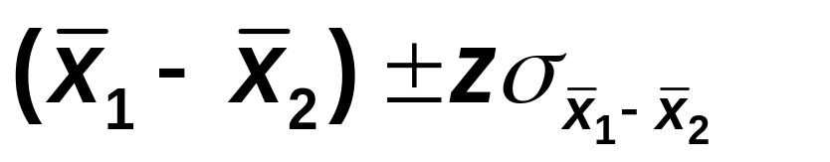
Point & Confidence Interval for μ₁ – μ₂
is the point estimator of μ₁ – μ_{2.}
The (1–α)100% confidence interval for μ₁ – μ₂ is

Slide 8
Example 10-1
A 2008 survey of low- and middle-income households conducted by Demos, a liberal public group, showed that consumers aged 65 years and older had an average credit card debt of $10,235 and consumers in the 50- to 64-year age group had an average credit card debt of $9342 at the time of the survey (USA TODAY, July 28, 2009).
Suppose that these averages were based on random samples of 1200 and 1400 people for the two groups, respectively.
Further assume that the population standard deviations for the two groups were $2800 and $2500, respectively.

Slide 9
Example 10-1
Let μ₁ and μ₂ be the respective population means for the two groups, people aged 65 years and older and people in the 50- to 64-year age group.
What is the point estimate of μ₁ – μ₂?
Construct a 97% confidence interval for μ₁ – μ₂.
What is the margin of error?

Slide 10

Example 10-1: Solution
(a)
Point estimate of μ₁ – μ₂ is
= $10,235 - $9342
= $893

Slide 11
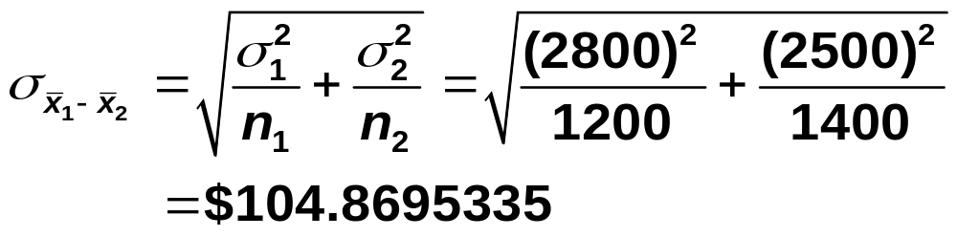
Example 10-1: Solution
(b)

Slide 12
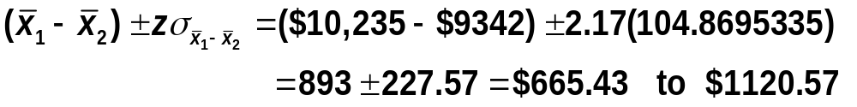
Example 10-1: Solution
(b)
97% confidence level. The value of z is 2.17
Comment: Thus, with 97% confidence we can state that the difference between the means of 2008 credit card debts for the two groups is between $665.43 to $1120.57.
(c) The margin of error is 227.57.

Slide 13
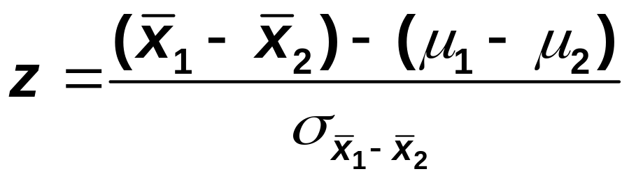
Hypothesis Testing About μ₁ – μ₂
When using the normal distribution, the test statistic is
The value of μ₁ – μ₂ is substituted from H₀.

Slide 14
Example 10-2
Refer to Example 10-1 about the average 2008 credit card debts for consumers of two age groups.
Test at the 1% significance level whether the population means for the 2008 credit card debts for the two groups are different.

Slide 15
Example 10-2: Solution
Step 1:
H₀: μ₁ – μ₂ = 0 (The two population means are not different.)
H₁: μ₁ – μ₂ ≠ 0 (The two population means are different.)

Slide 16
Example 10-2: Solution
Step 2:
Population standard deviations, σ₁ and σ₂ are known
Therefore, we use the normal distribution to perform the hypothesis test

Slide 17
Example 10-2: Solution
Step 3:
α = .01.
The ≠ sign in the alternative hypothesis indicates that the test is two-tailed
Area in each tail = α / 2 = .01 / 2 = .005
The critical values of z are 2.58 and -2.58

Slide 18
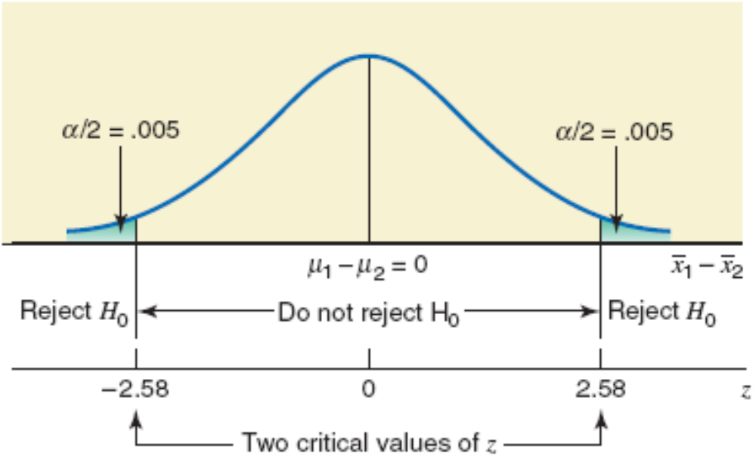
Figure 10.2

Slide 19
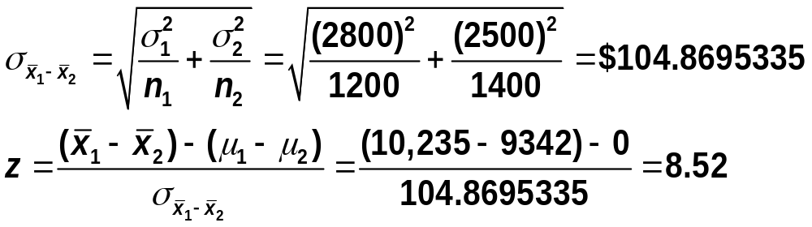
Example 10-2: Solution
Step 4:
From H₀

Slide 20
Example 10-2: Solution
Step 5:
Because the value of the test statistic z = 8.52 falls in the rejection region, we reject the null hypothesis H₀.
Step 6: Therefore, we conclude that the mean 1008 credit card debts for the two age groups mentioned in this example are different.

Slide 21
10.2 INFERENCES ABOUT THE DIFFERENCE BETWEEN TWO POPULATION MEANS FOR PAIRED SAMPLES
Estimation of μ_{d}
Hypothesis Testing About μ_{d}

Slide 22
INFERENCES ABOUT THE DIFFERENCE BETWEEN TWO POPULATION MEANS FOR PAIRED SAMPLES
Definition
Two samples are said to be paired or matched samples when for each data value collected from one sample there is a corresponding data value collected from the second sample, and both these data values are collected from the same source.

Slide 23


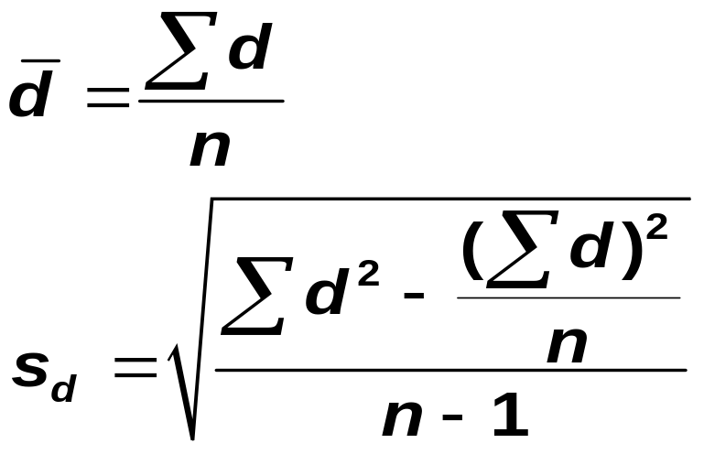
INFERENCES ABOUT THE DIFFERENCE BETWEEN TWO POPULATION MEANS FOR PAIRED SAMPLES
Mean and Standard Deviation of the Paired Differences for Two Samples
The values of the mean and standard deviation, and , respectively, of paired differences for two samples are calculated as

Slide 24
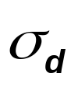
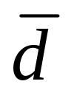
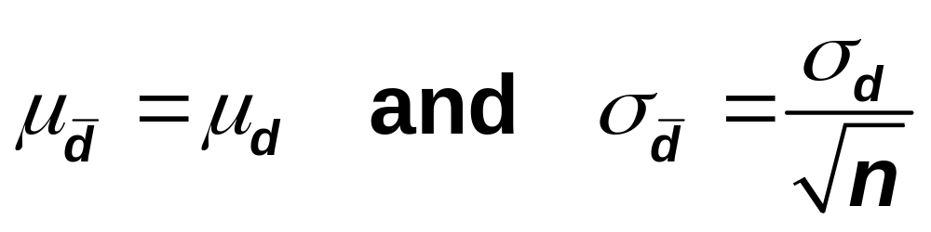
INFERENCES ABOUT THE DIFFERENCE BETWEEN TWO POPULATION MEANS FOR PAIRED SAMPLES
Sampling Distribution, Mean, and Standard Deviation of d
If is known and either the sample size is large (n ≥ 30) or the population is normally distributed, then the sampling distribution of is approximately normal with its mean and standard deviation given as, respectively.

Slide 25
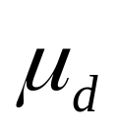
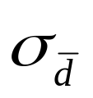
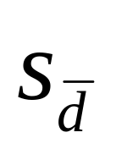
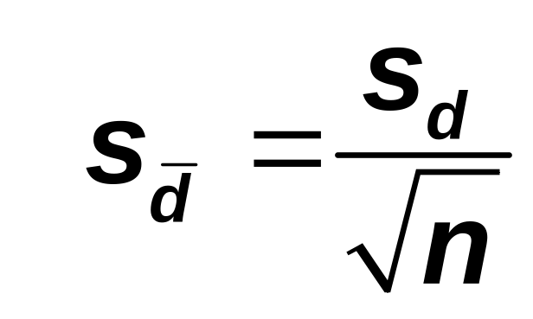
INFERENCES ABOUT THE DIFFERENCE BETWEEN TWO POPULATION MEANS FOR PAIRED SAMPLES
Estimate of the Standard Deviation of Paired Differences
then the t distribution is used to make inferences about . The standard deviation of of is estimated by , which is calculated as

Slide 26
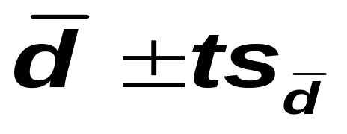
Interval Estimation of μ_{d}
Confidence Interval for μ_{d}
The (1 – α)100% confidence interval for μ_{d} is
where the value of t is obtained from the t distribution table for the given confidence level and n – 1 degrees of freedom, and is calculated as explained earlier.

Slide 27
Example
A researcher wanted to find the effect of a special diet on systolic blood pressure.
She selected a sample of seven adults and put them on this dietary plan for 3 months.
The following table gives the systolic blood pressures (in mm Hg) of these seven adults before and after the completion of this plan.

Slide 28

Example
Let μ_{d} be the mean reduction in the systolic blood pressure due to this special dietary plan for the population of all adults. Construct a 95% confidence interval for μ_{d}. Assume that the population of paired differences is (approximately) normally distributed.
HW: (i)Write down the point estimate of μ_{d.} (ii) Margin of error

Slide 29
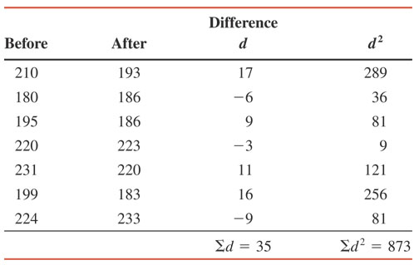
Example: Solution
Table 10.1

Slide 30
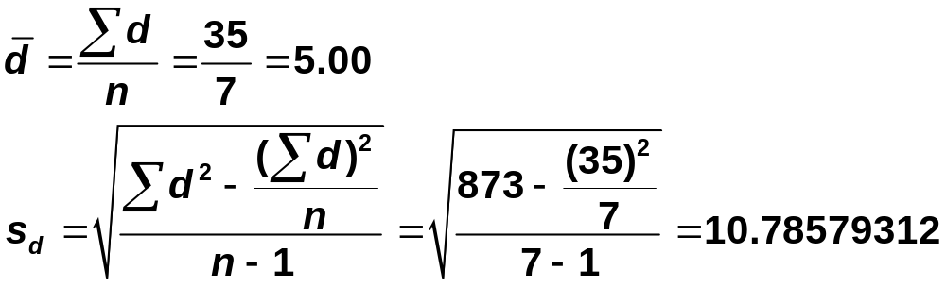
Example: Solution

Slide 31
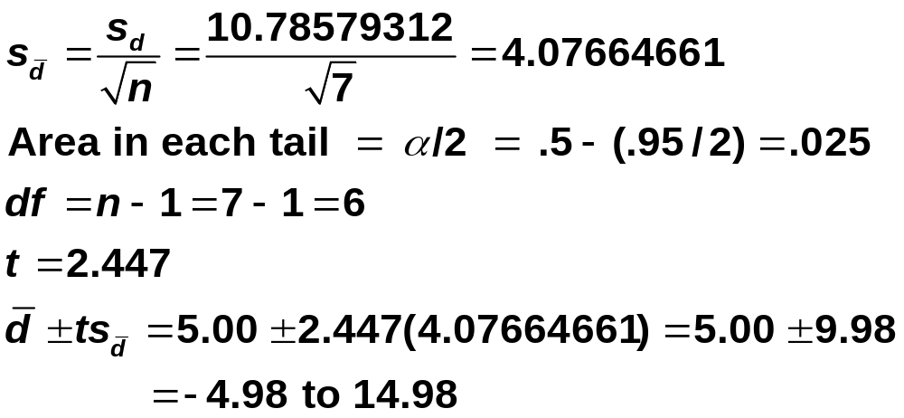
Example: Solution
Hence,

Slide 32
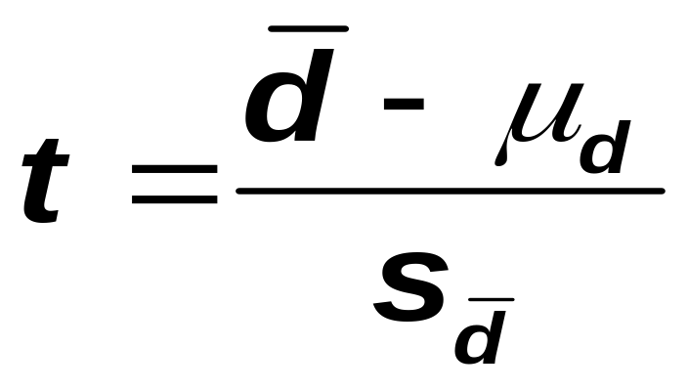
Hypothesis Testing About μ_{d}
Test Statistic
The value of the test statistic t for is computed as follows:

Slide 33
Example
A company wanted to know if attending a course on “how to be a successful salesperson” can increase the average sales of its employees. The company sent six of its salespersons to attend this course.
The following table gives the 1-week sales of these salespersons before and after they attended this course.

Slide 34

Example
Using the 1% significance level, can you conclude that the mean weekly sales for all salespersons increase as a result of attending this course?
Assume that the population of paired differences has a normal distribution.

Slide 35
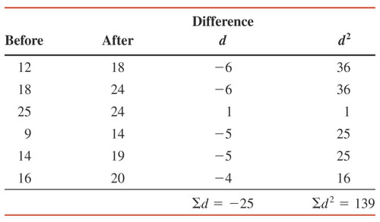
Example: Solution
Table 10.2

Slide 36
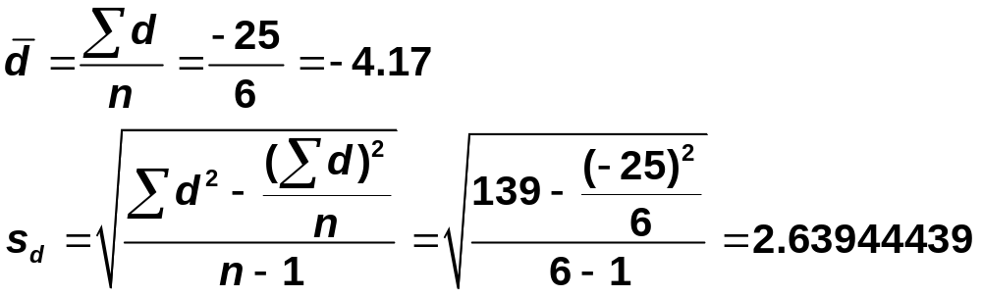
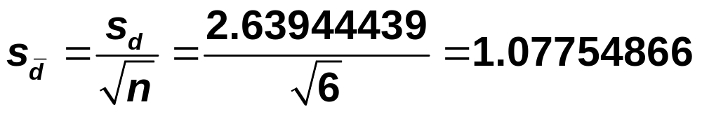
Example: Solution

Slide 37
Example: Solution
Step 1:
H₀: μ_{d} = 0
  μ₁ – μ₂ = 0 or the mean weekly sales do not increase
H₁: μ_{d} < 0
  μ₁ < μ₂
  μ₁ – μ₂ < 0 or the mean weekly sales do increase

Slide 38
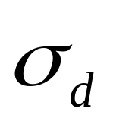
Example: Solution
Step 2:
is unknown
The sample size is small (n < 30)
The population of paired differences is normal
Therefore, we use the t distribution to conduct the test

Slide 39
Example: Solution
Step 3:
α = .01.
df = n – 1 = 6 – 1 = 5
The critical value of t is -3.365

Slide 40
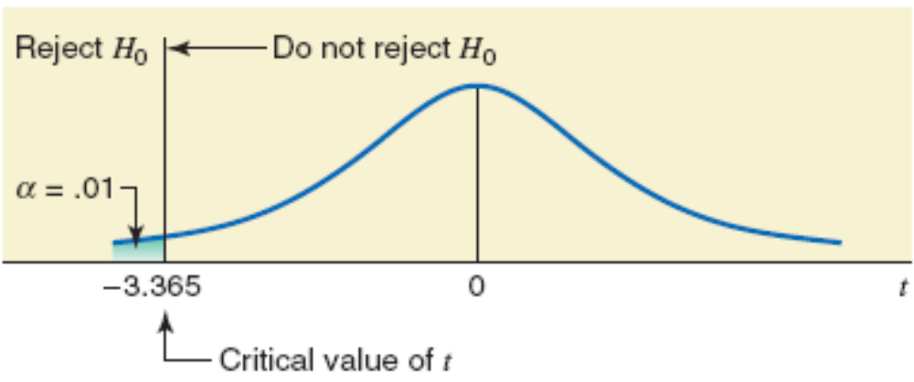
Figure

Slide 41
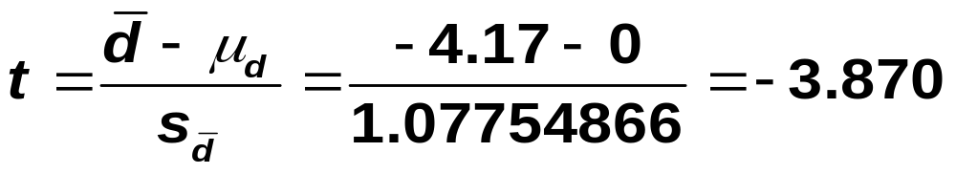
Example: Solution
Step 4:

Slide 42
Example: Solution
Step 5:
The value of the test statistic t = -3.870
  It falls in the rejection region
Therefore, we reject the null hypothesis
Step 6: Consequently, we conclude that the mean weekly sales for all salespersons increase as a result of this course.

Slide 43
R Code: Paired t-test
before<-c(12,18,25,9,14,16)
after<- c(18,24,24,14,19,20)
t.test(before, after, alternative = "less",paired = TRUE)
Output:
data: before and after
t = -3.8668, df = 5, p-value = 0.005899

Slide 44
Example
Refer to Example 10-10. The table that gives the blood pressures (in mm Hg) of seven adults before and after the completion of a special dietary plan is reproduced here.

Slide 45
Example
Let μ_{d} be the mean of the differences between the systolic blood pressures before and after completing this special dietary plan for the population of all adults.
Using the 5% significance level, can we conclude that the mean of the paired differences μ_{d} is different from zero?
Assume that the population of paired differences is (approximately) normally distributed.

Slide 46
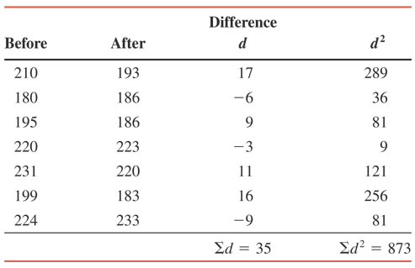
Example: Solution
Table 10-3

Slide 47
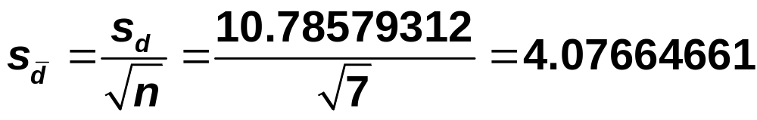
Example: Solution

Slide 48
Example: Solution
Step 1:
H₀: μ_{d} = 0
  The mean of the paired differences is not different from zero
H₁: μ_{d} ≠ 0
  The mean of the paired differences is different from zero

Slide 49
Example: Solution
Step 2:
is unknown
The sample size is small
The population of paired differences is (approximately) normal
We use the t distribution to make the test.

Slide 50
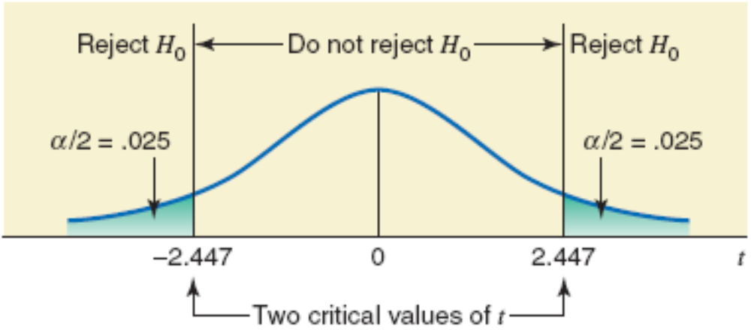
Example: Solution
Step 3:
α = .05
df = n – 1 = 7 – 1 = 6
The two critical values of t are -2.447 and 2.447

Slide 51
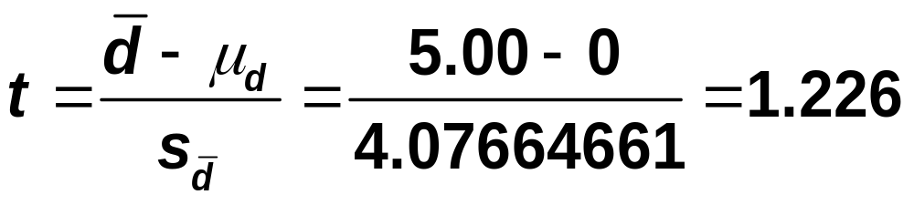
Example: Solution
Step 4:

Slide 52
Example: Solution
Step 5:
The value of the test statistic t = 1.226
It falls in the nonrejection region
Therefore, we fail to reject the null hypothesis
Step 6:
Hence, we conclude that the mean of the population paired difference is not different from zero.
……………………………….

